Slide 1
CS 663 Project
190050011 - Akshay Chaurasia - Report, Code
190050035 - Divyansh Nankani - Report, Code Skeleton
190050047 - Hardik Siloiya - Report, Code

Slide 2
Objective
In this project, we try to detect image splicing and perturbation (adding noise to certain parts of image).
We use the paper by Siwei Lyu et al. as the primary reference for implementing this project, using detection of local noise variance inconsistencies in different parts of the image.
Dataset - Siwei Lyu download (albany.edu)

Slide 3
Working (1)
The Principle behind Image Splicing Detection technique for paper we implemented is - The Noise Variance will be different for the different splices of a spliced image.
We use the algorithm used for computing global noise variance to compute local noise variance at each pixel.
The Concept used behind Algorithm for Global Noise Variance is that Kurtosis Value for Natural Images tend to be a constant, a phenomenon called Kurtosis concentration

Slide 4

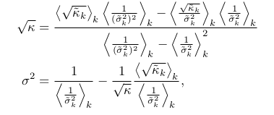
Working (2)
Kurtosis value is given by:
-3 , where and sigma is the
standard deviation.
= kurtosis value of the window for kth channel.

Slide 5


Working (3)
Formula for noise variance is obtained by minimizing squared differences between two sides of the equation :
Where is kurtosis of the noisy(or given) image ,while is kurtosis value of the original image (without noise).
For Performance efficiency ,we use raw moments to compute variance and kurtosis value for the window at a given pixel for a base.

Slide 6
Working (4)
Apply 64 Band-pass filters obtained from a 8x8 DCT Decomposition on the given image to get 64 transformed images.
Compute Integral Image for first four raw moments to improve performance efficiency.
Compute Kurtosis value per pixel over a local window around the pixel.
Remove pixels on the boundary so as to remove the unexpected noise variance values due to boundary.
Applying Heat-Map, Kmeans, segmentation algorithms.

Slide 7
Metric
Confusion Matrix:
Actual/ Predicted | Spliced | Authentic
Spliced | 47 | 16
Authentic | 14 | 53

Slide 8
Precision Metrics
Images - Spliced - 61 Authentic - 69 Total -130
Precision - 0.74
Recall - 0.77
F1 score - 0.754

Slide 9
Results on Spliced Images

Slide 10
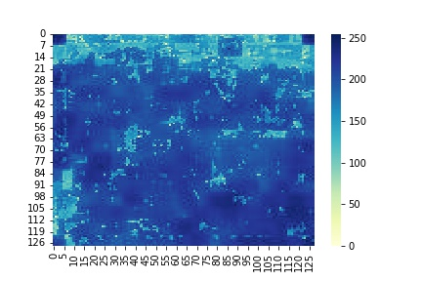
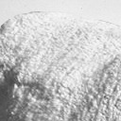
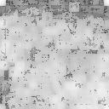

Slide 11
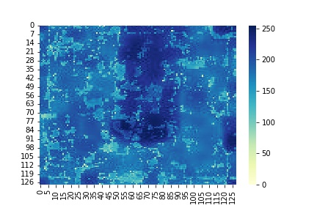
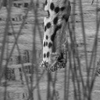
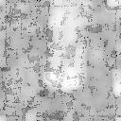

Slide 12
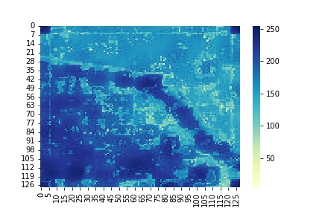
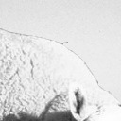
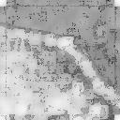

Slide 13
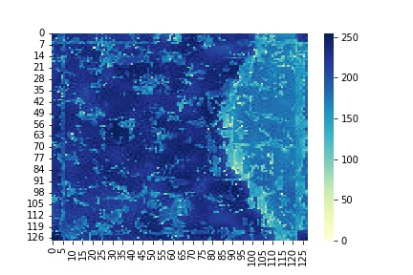
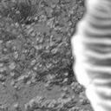
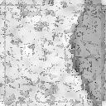

Slide 14
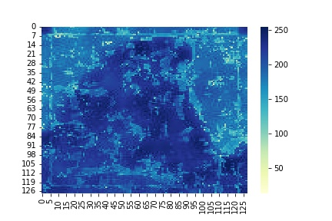
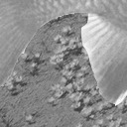
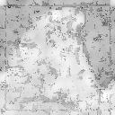

Slide 15
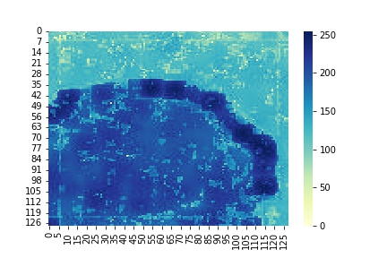
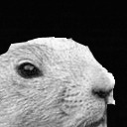
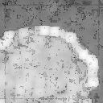

Slide 16
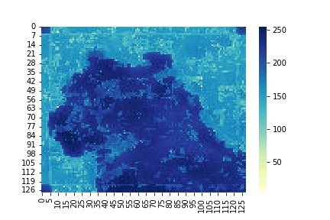
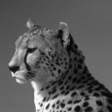
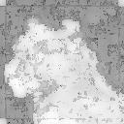

Slide 17
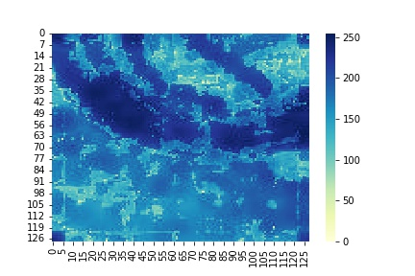

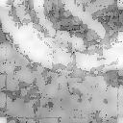

Slide 18
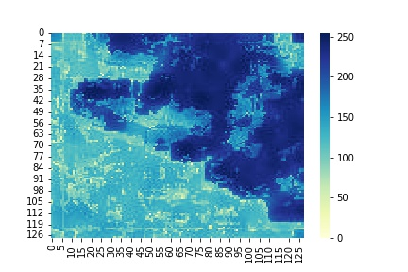
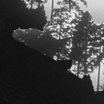
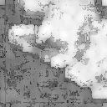

Slide 19
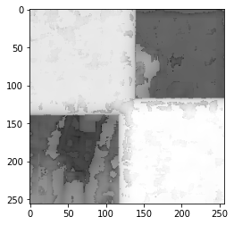
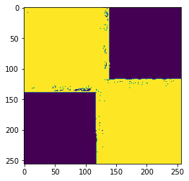
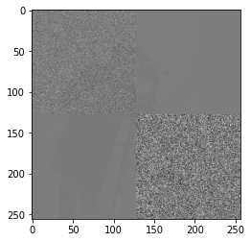
Synthetic Image with different noise added
Spliced image Noise Variance (log scale) K-means noise clustering

Slide 20
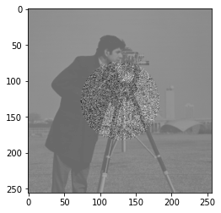
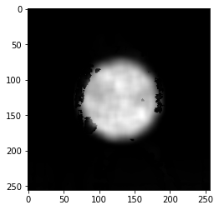
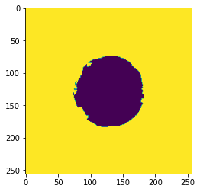
Synthetic Image with different noise added
Spliced image Noise Variance (log scale) K-means noise clustering

Slide 21
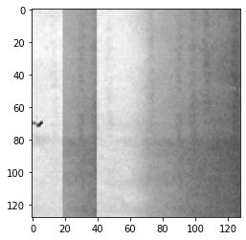
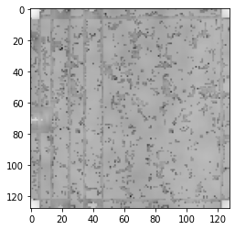
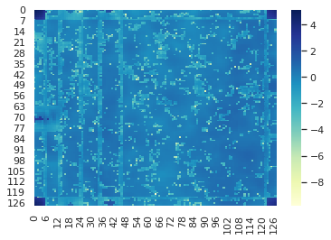
A case of False negative

Slide 22
Results on Authentic Images

Slide 23
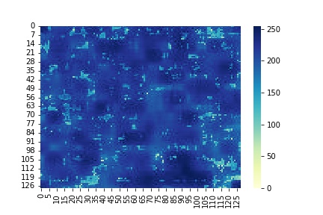
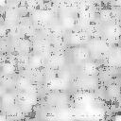
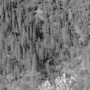

Slide 24
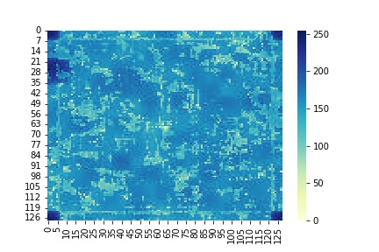
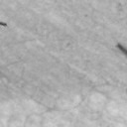
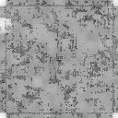

Slide 25
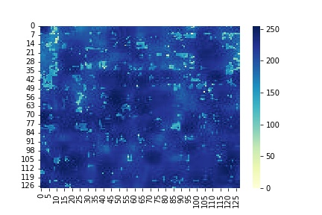
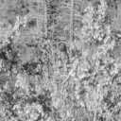


Slide 26
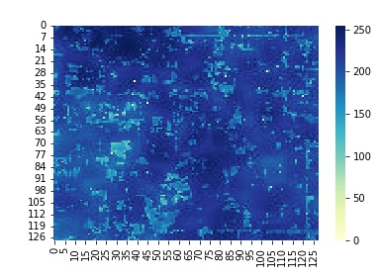
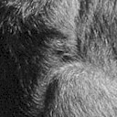
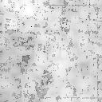

Slide 27
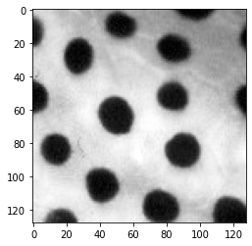
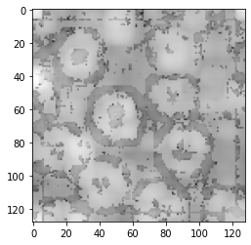
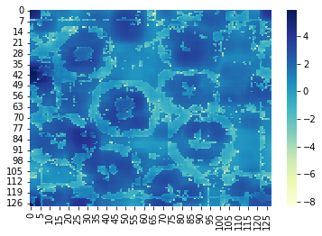
A case of false positive

Slide 28



Another Case of False Positive

Slide 29



Another case of False Positive

Slide 30
Interesting Observations
If noise variance of the image being spliced is equivalent to the spliced patch, then algorithm is not able to detect splicing hence leading to false negative result.
Presence of large gradient differences or shape boundaries in the image can also lead to false detection of splicing on authentic image.

Slide 31
Interesting observations
If a noise having very low variance to an image is added, then the intra-spliced noise variations overpower the inter-splice noise (the low noise added to the image).
High noise variation present in non-spliced parts of pictures interferes with detection of noise variance based clusters, which give false result of splicing being done in the image.

